Slide 2
Case 1: Negative charges flow to the right
Result: Left side is more positive than before, Right side is more negative than before
Case 2: Positive charges flow to the left
+
+
+
+
Result: Left side is more positive than before, Right side is more negative than before

Slide 3
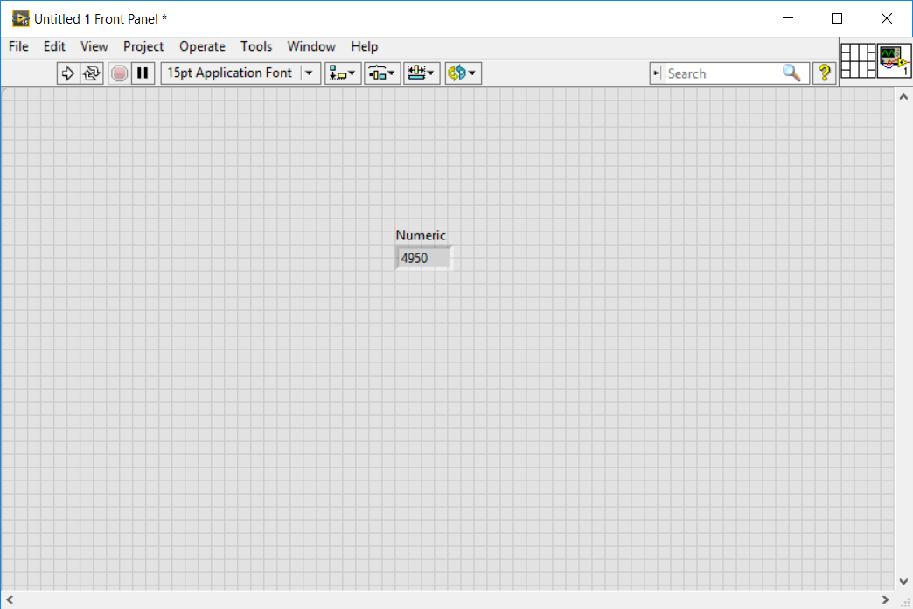
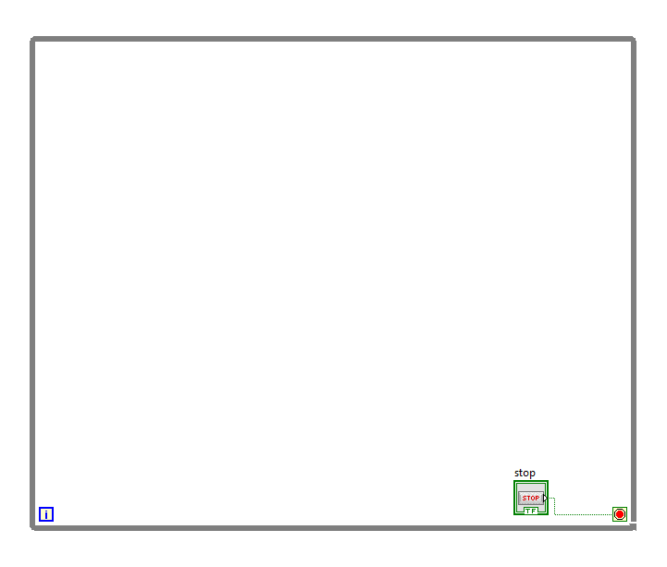
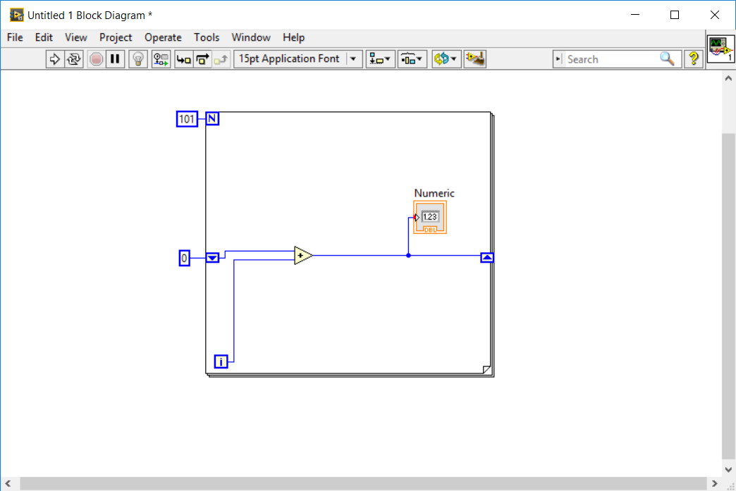

Slide 4
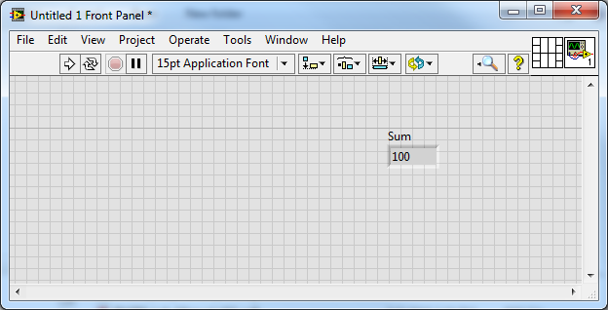
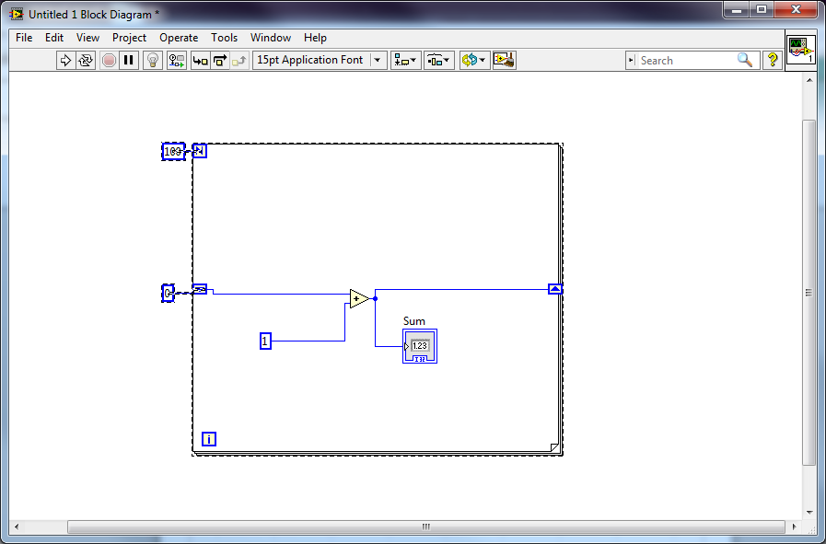

Slide 5
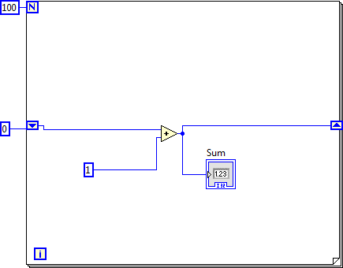

Slide 6
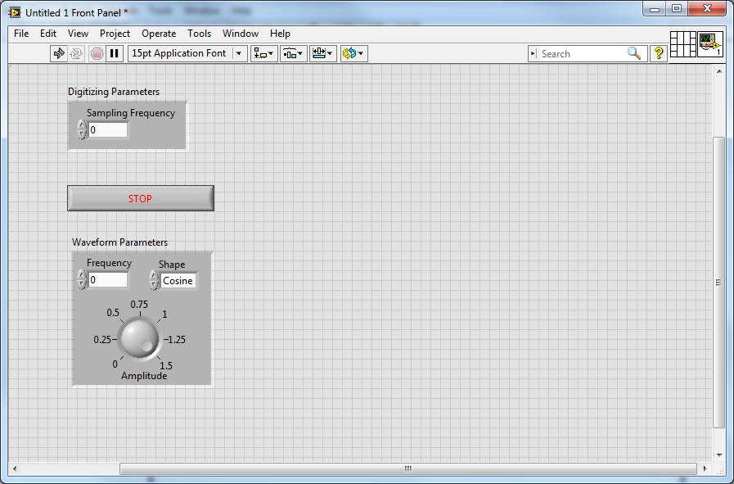

Slide 7
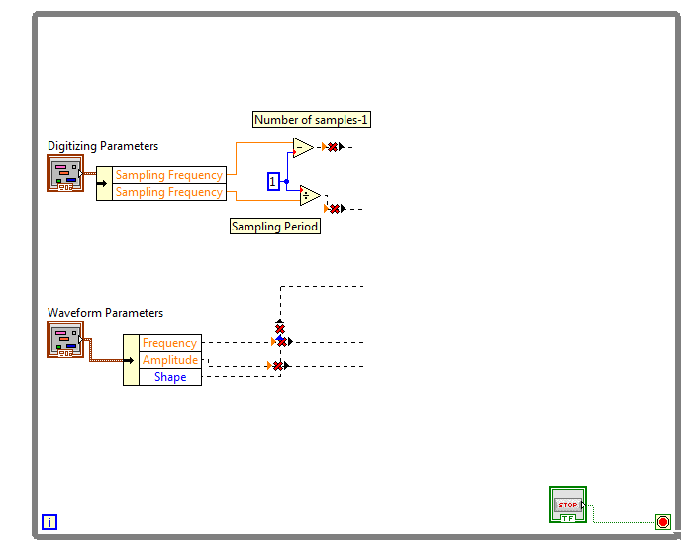

Slide 8
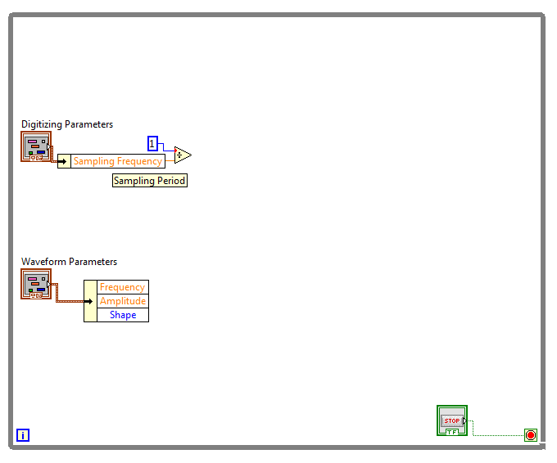

Slide 9
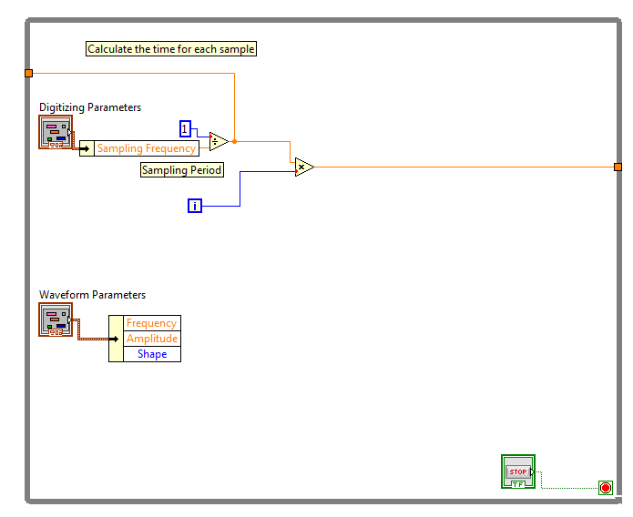

Slide 10
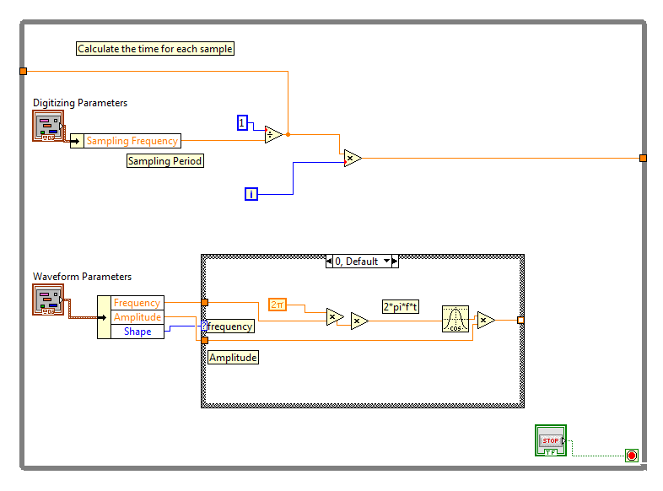

Slide 11
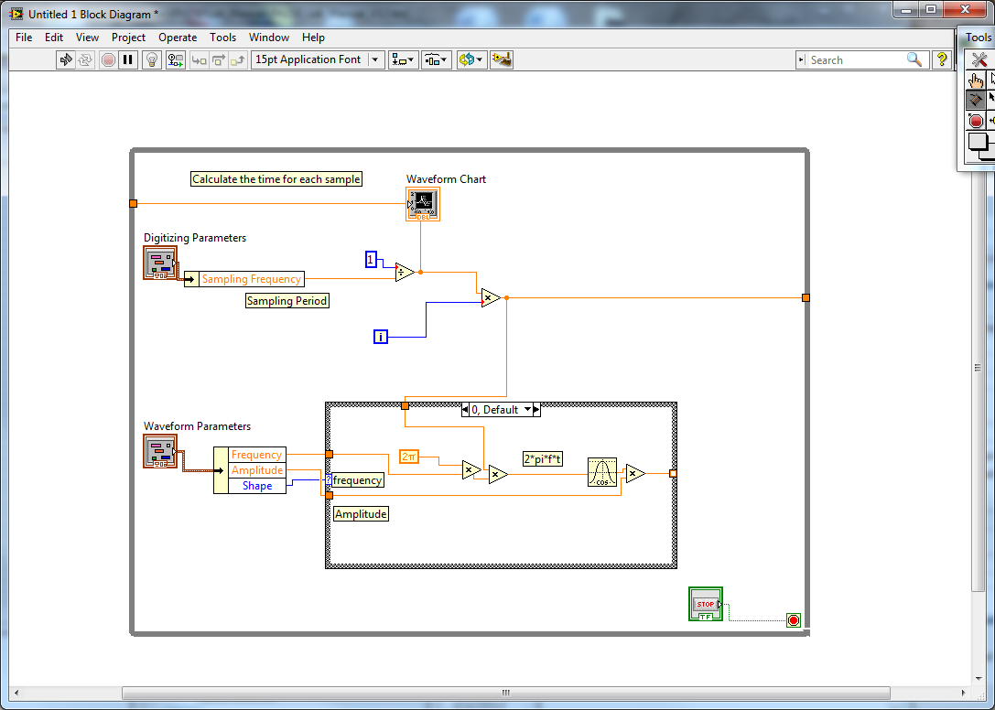

Slide 12
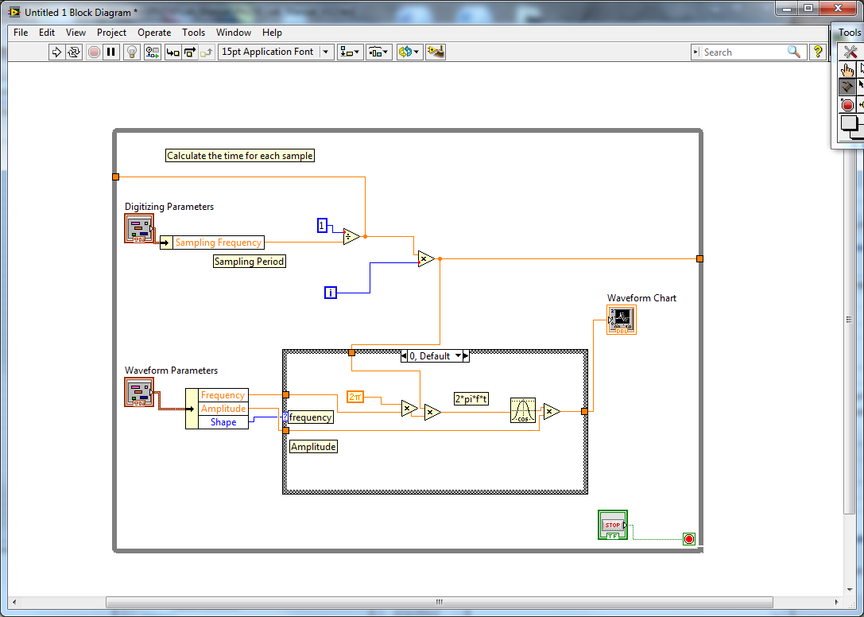

Slide 13
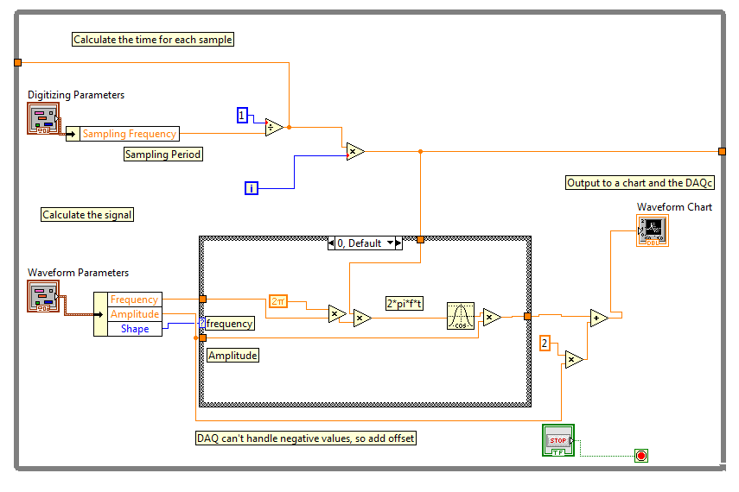

Slide 14
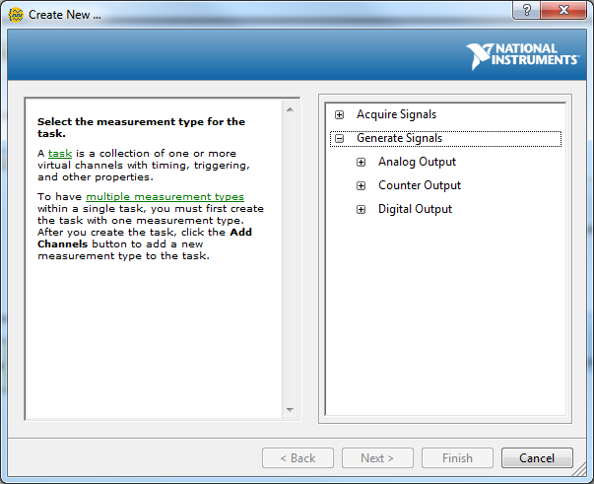

Slide 15
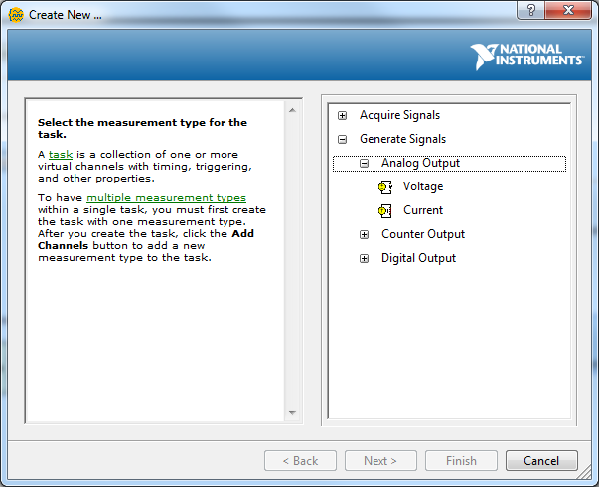

Slide 16
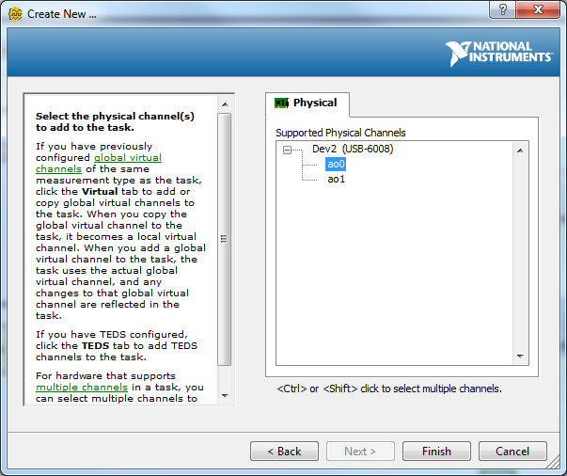

Slide 17
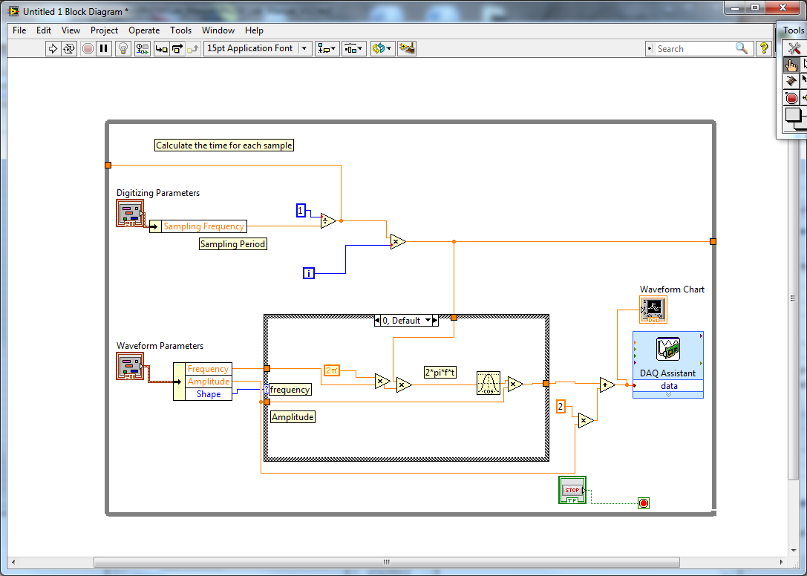
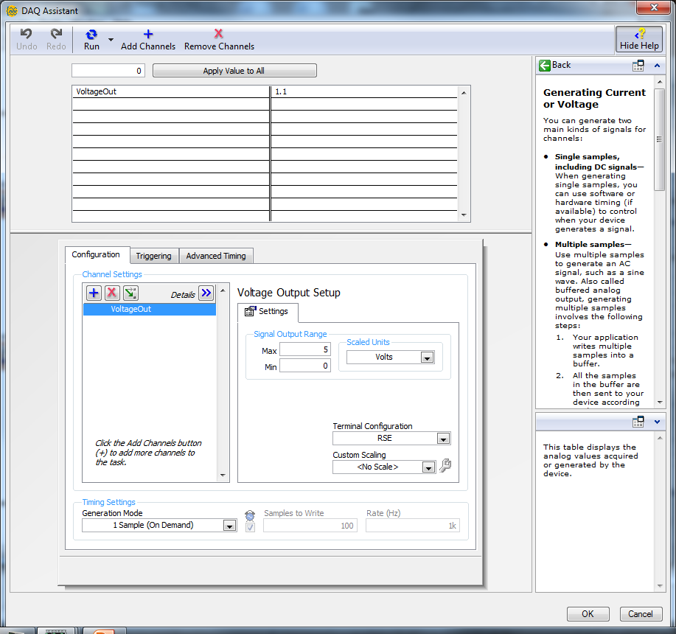

Slide 19
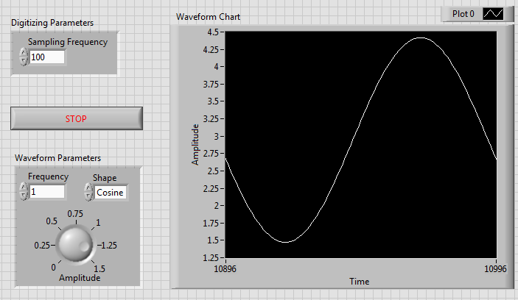

Slide 20
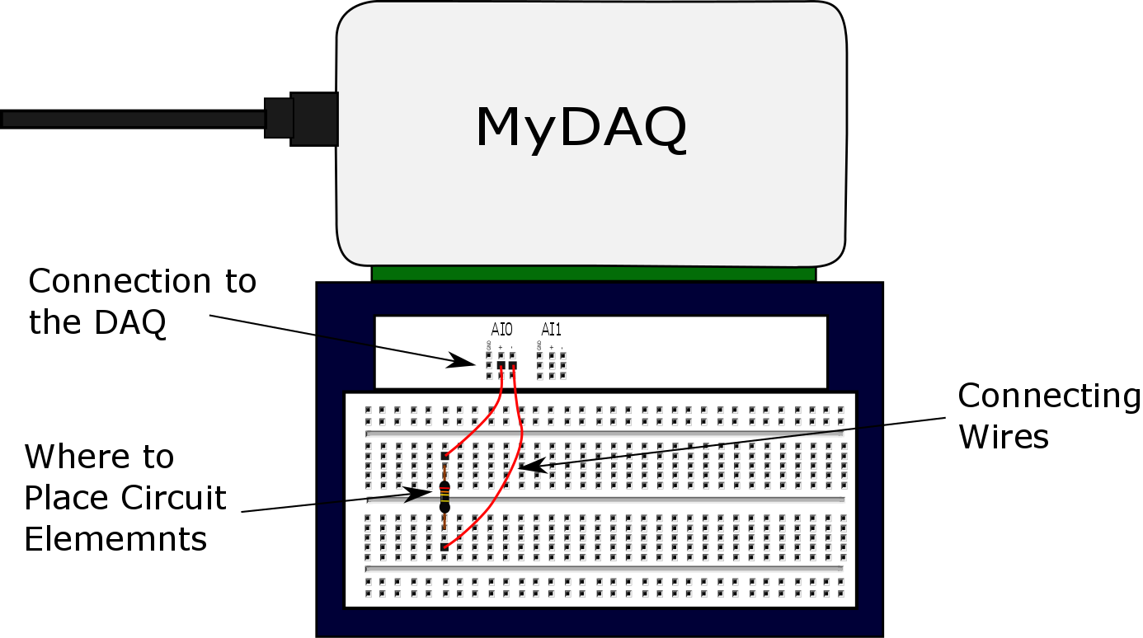
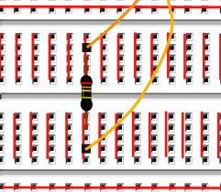
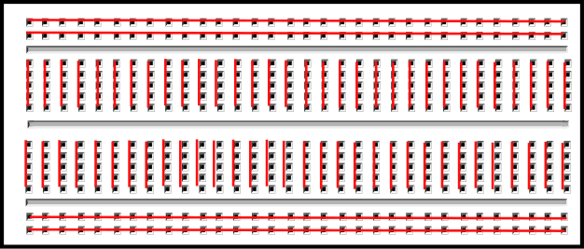
These two wires are connected
These two wires are connected

Slide 21
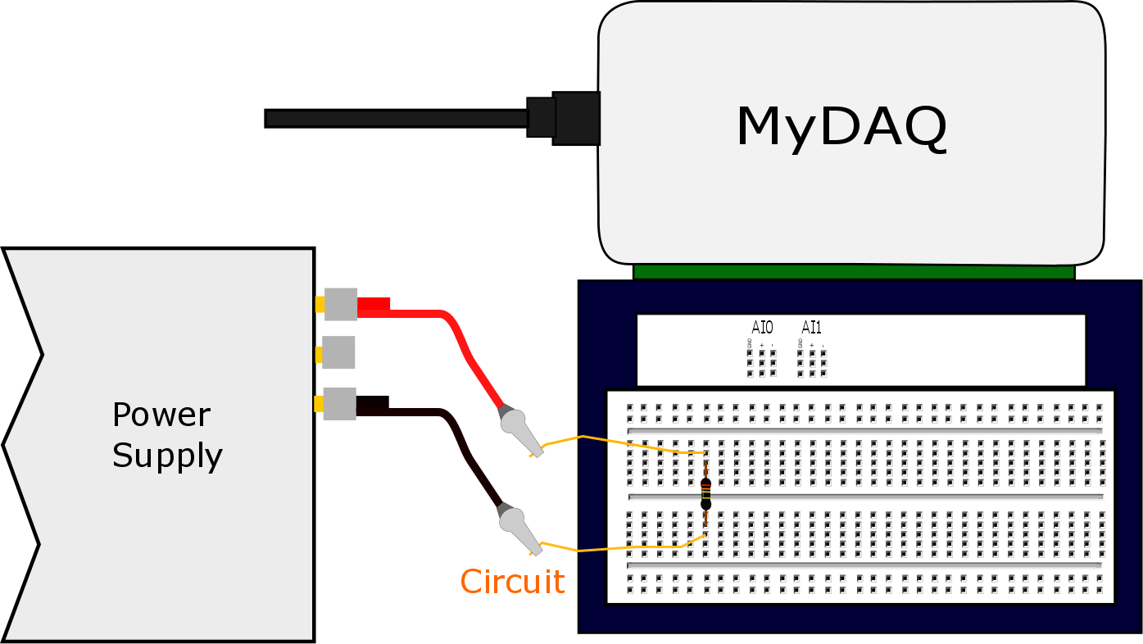
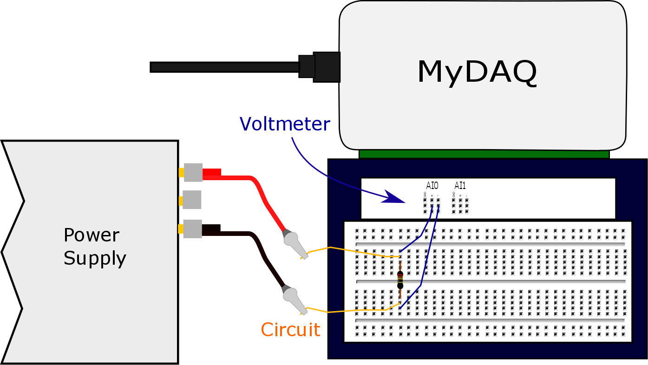
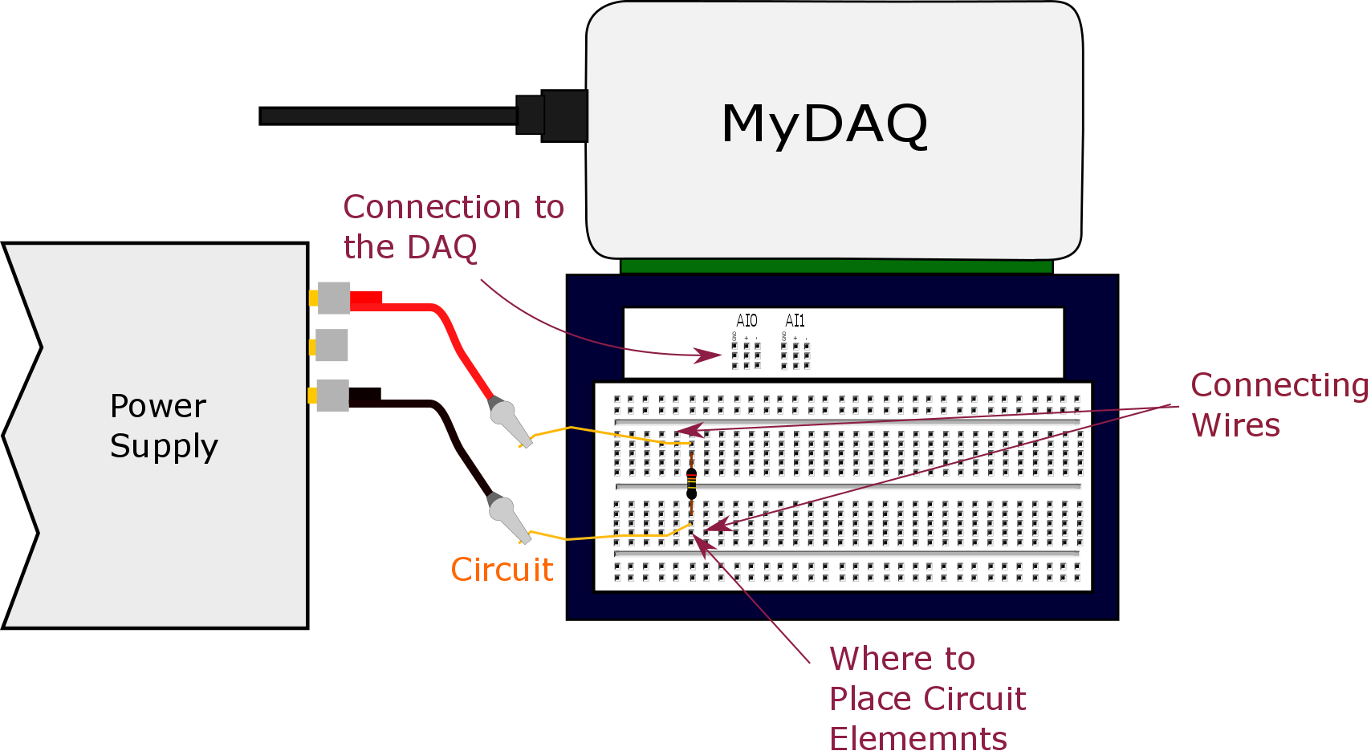

Slide 22
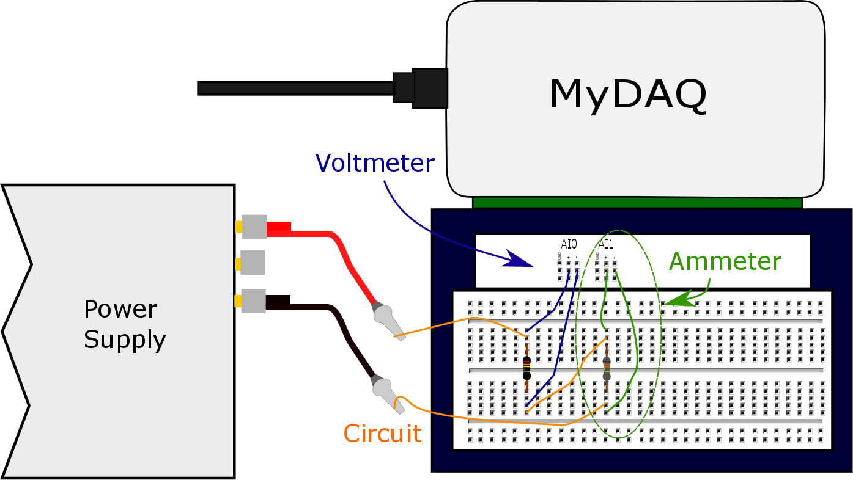

Slide 23


R
R₁
Δv
R₂
Measure

Slide 24

U_{g top}
ΔU_{g} = U_{g top}- U_{g bottom}
U_{g bottom}

Slide 25
V_{top}
Battery
Resistor
ΔV = V _{top}- V _{bottom}
V _{bottom}

Slide 26
5V
1024 divisions
Each division
Is 4.9mV
4.9mV
0V
4.9mV

Slide 27
4.9mV
4.9mV
6mV
4.9mV
0V

Slide 28
V_{top}
Battery
Resistor
ΔV = V _{top}- V _{bottom}
V _{bottom}

Slide 29
WARNING
If done wrong this step can destroy your Arduino

Slide 30
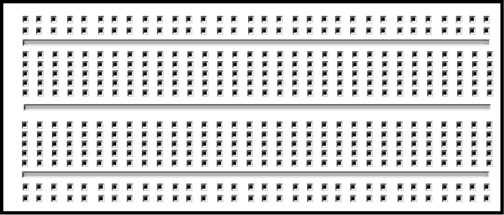

Slide 31
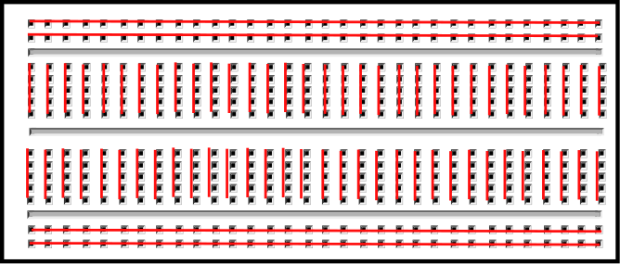
Usually used for positive and negative input voltages.

Slide 32
High Electrical Potential Energy
Battery
Resistor
ΔV
Voltmeter
Low Electrical Potential Energy

Slide 33
High Gravitational Potential Energy
ΔU
Low Gravitational Potential Energy

Slide 34
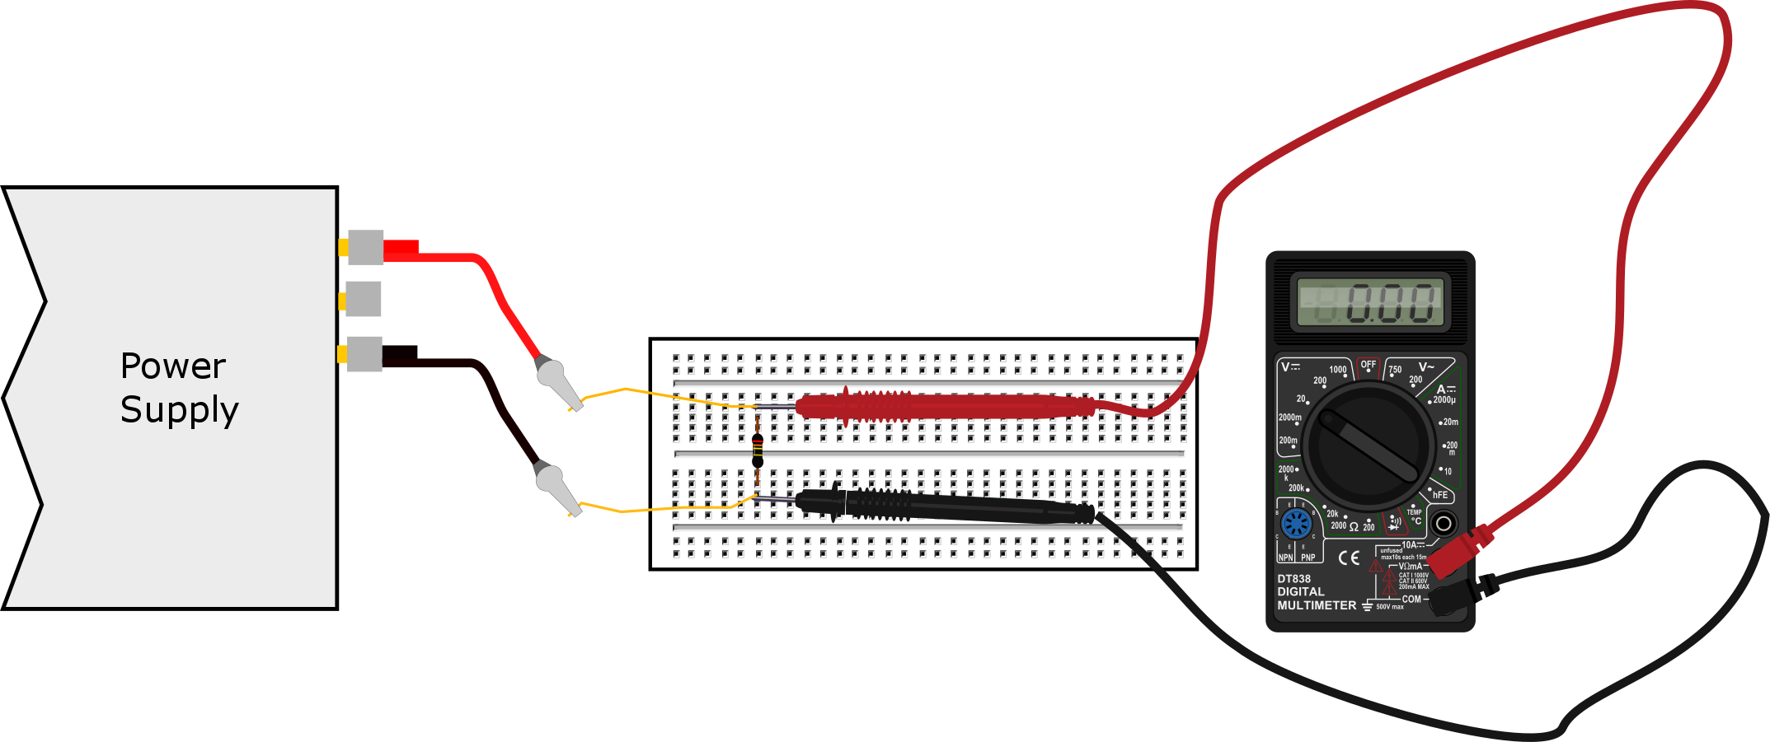

Slide 36
High Electrical Potential Energy
Battery
Resistor
Low Electrical Potential Energy
A
Break in the original wire
Ammeter

Slide 37
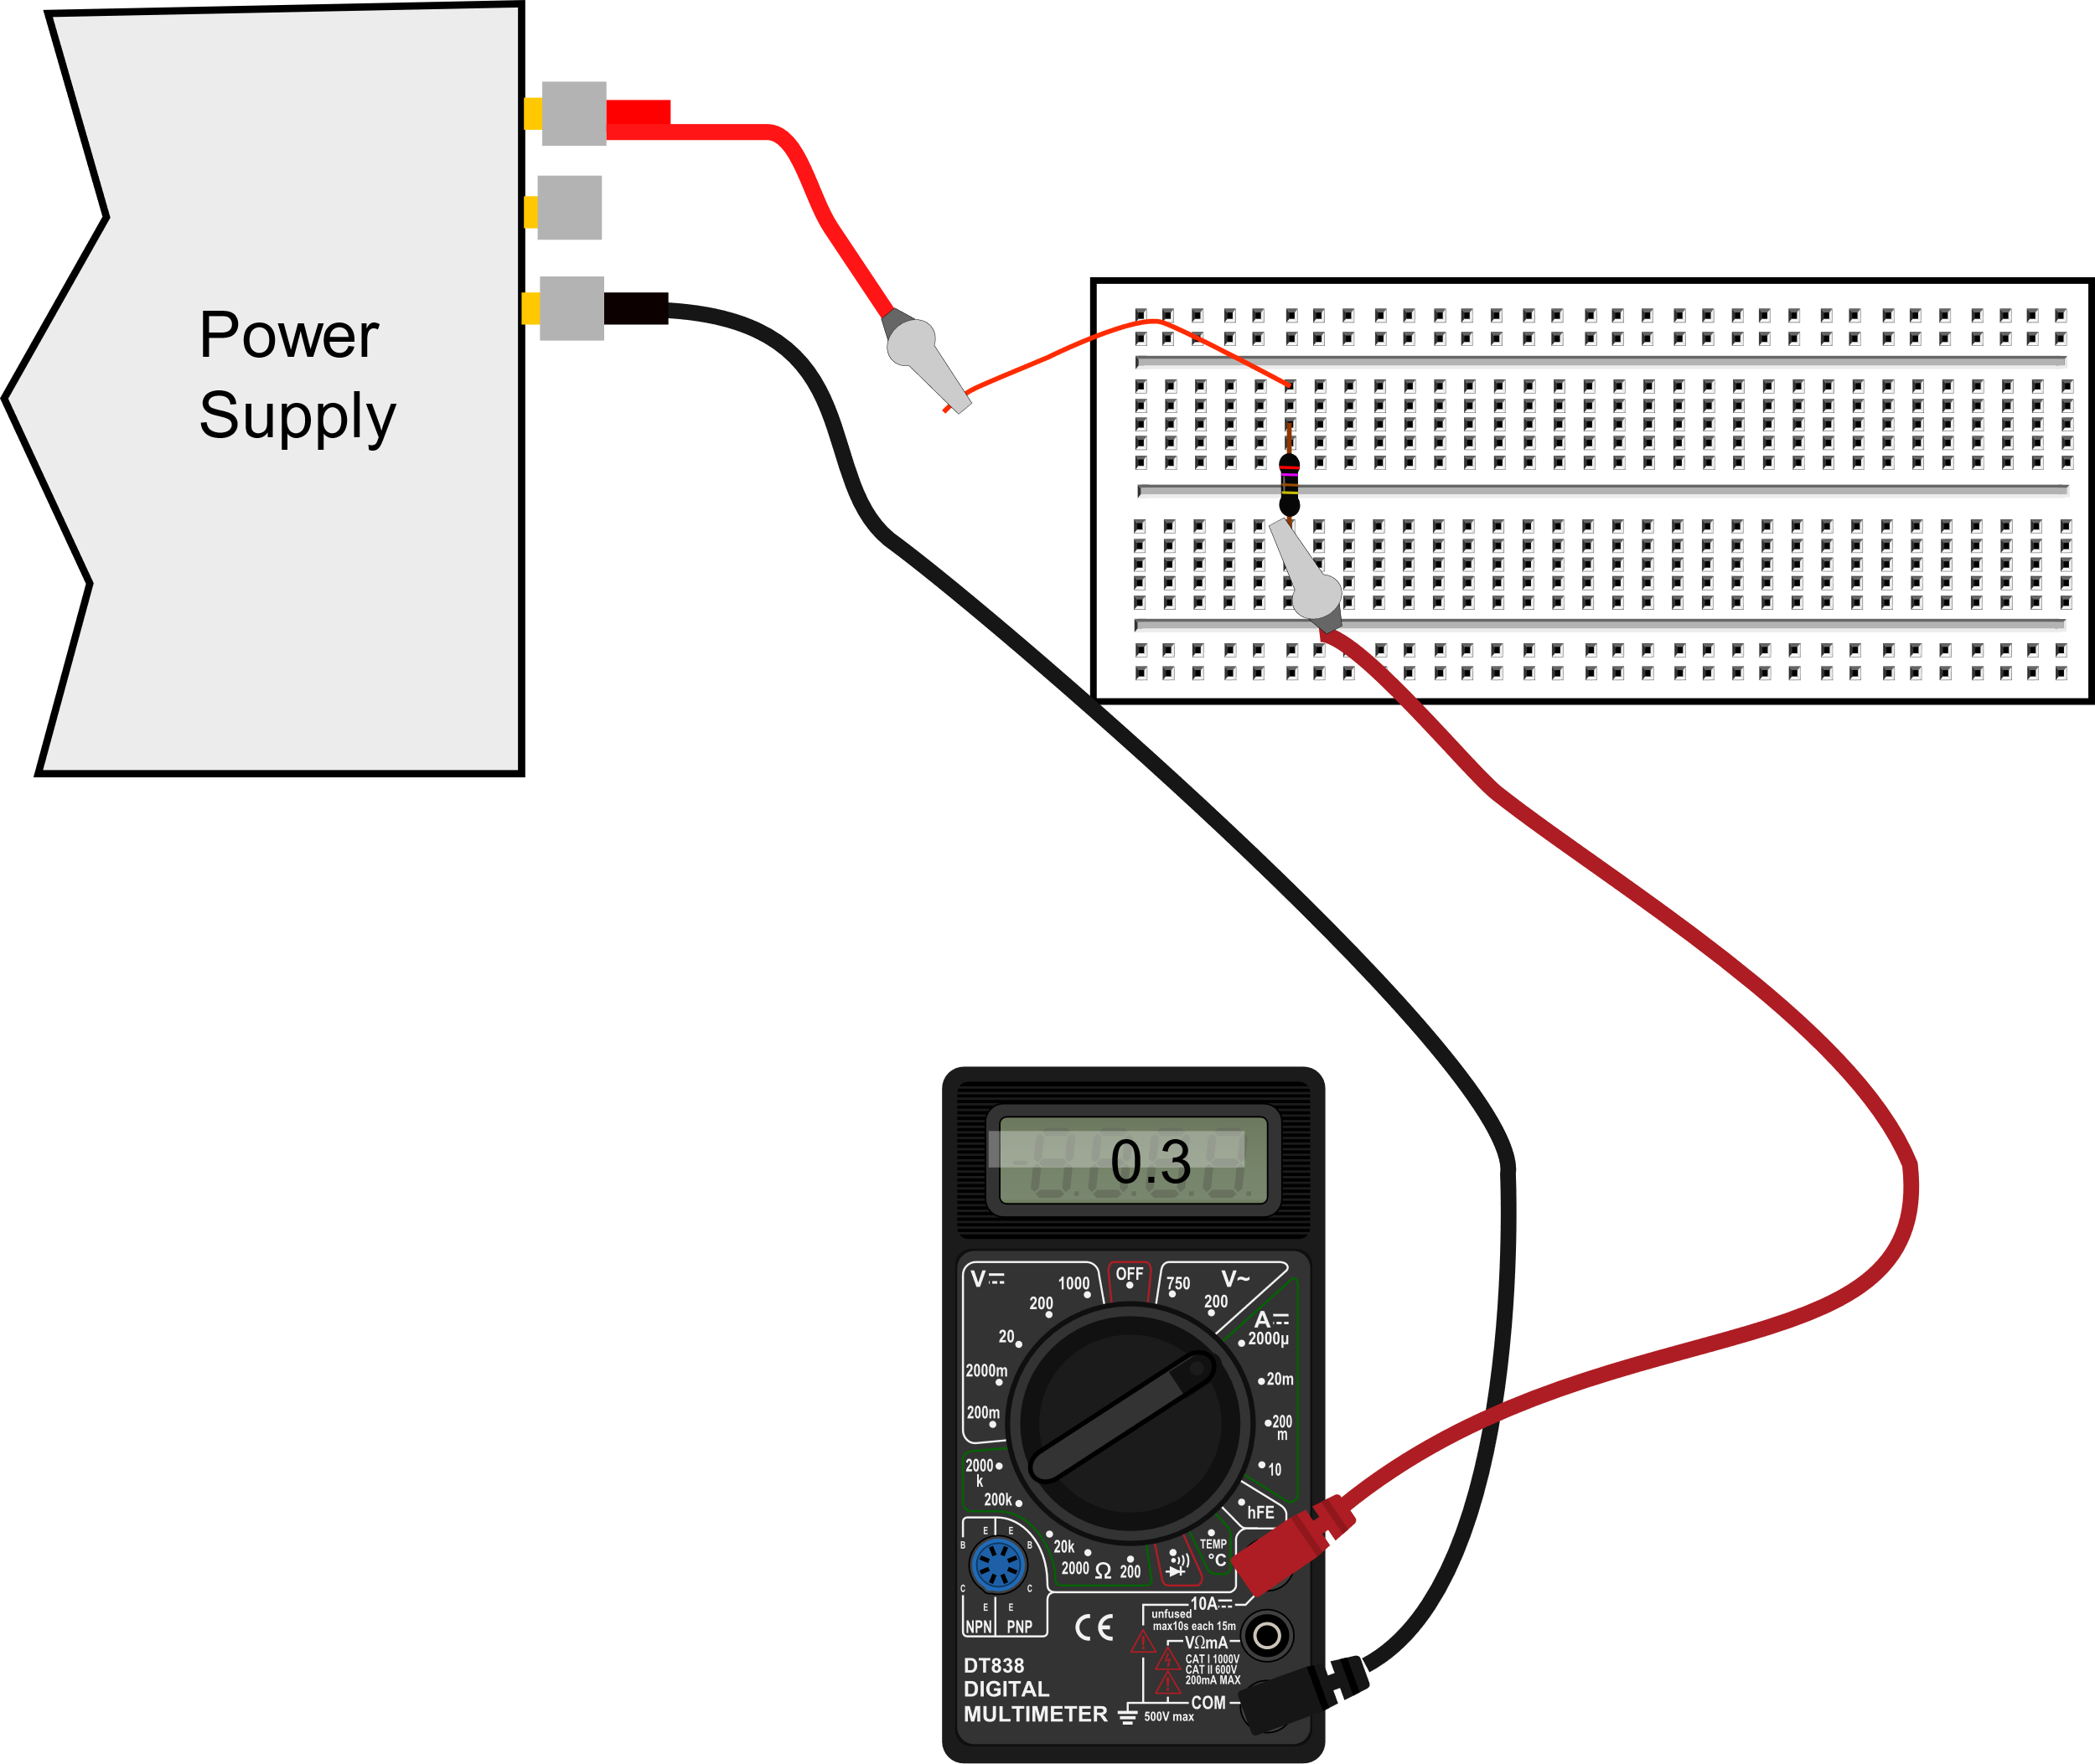

Slide 38
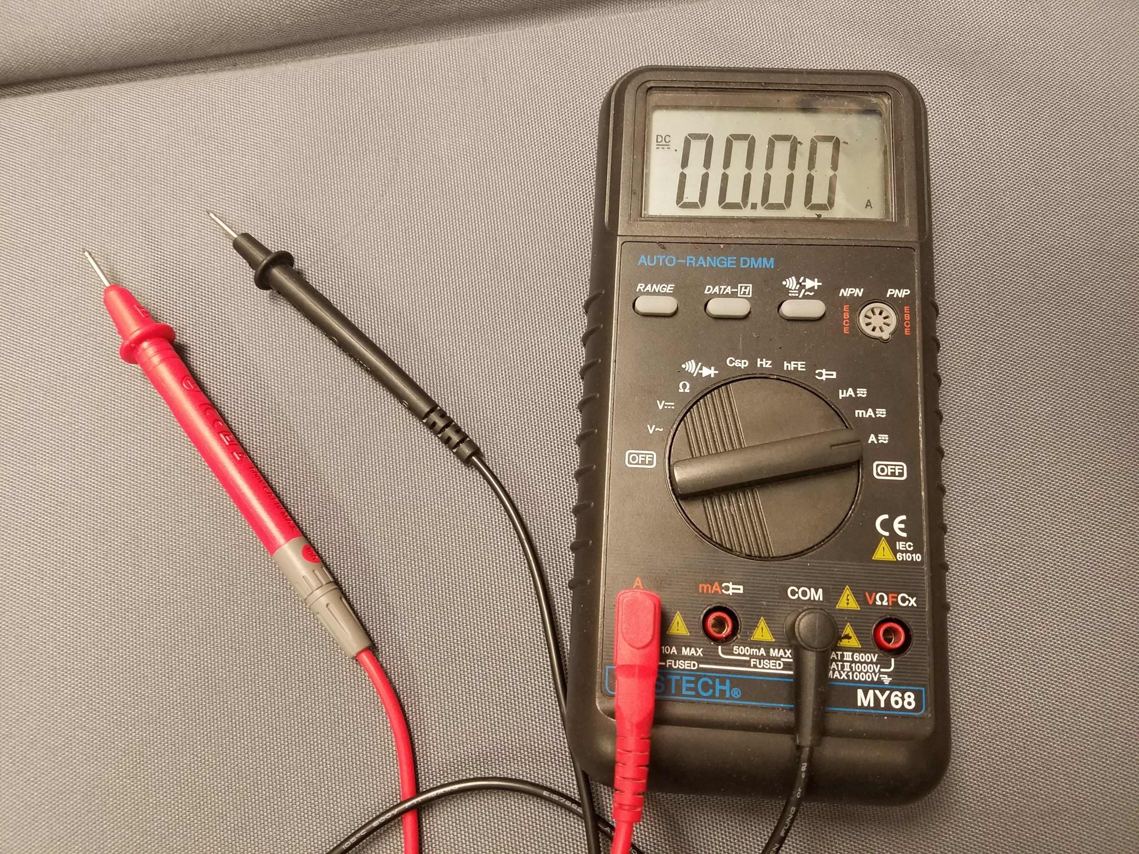
Amperage Setting
Different connector

Slide 39
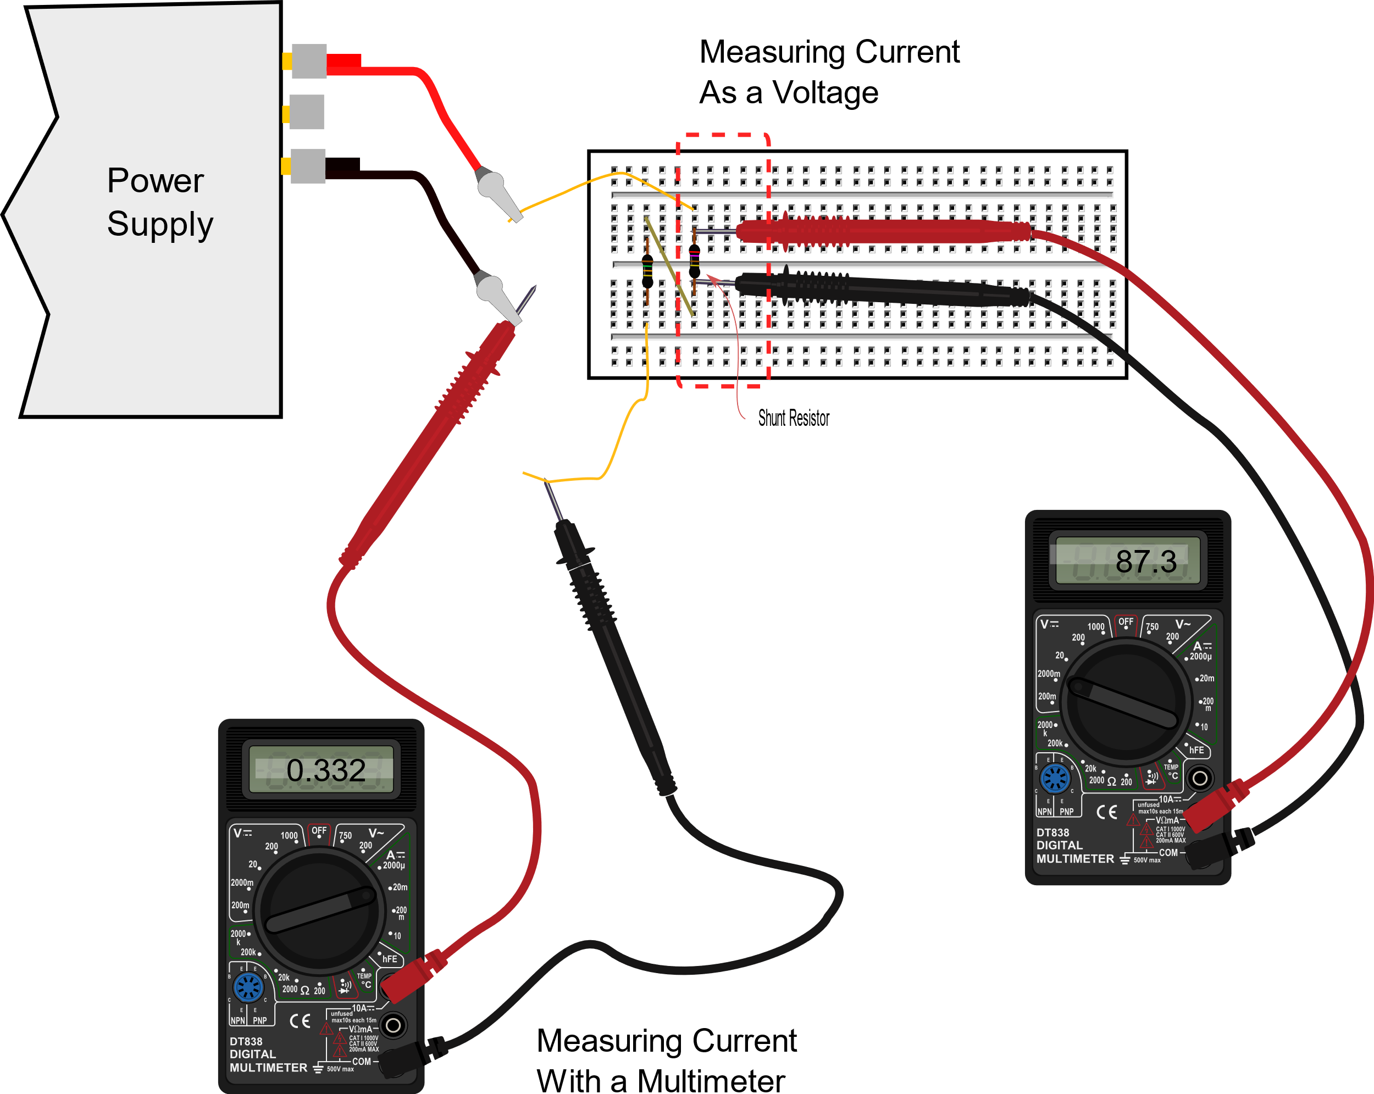

Slide 40
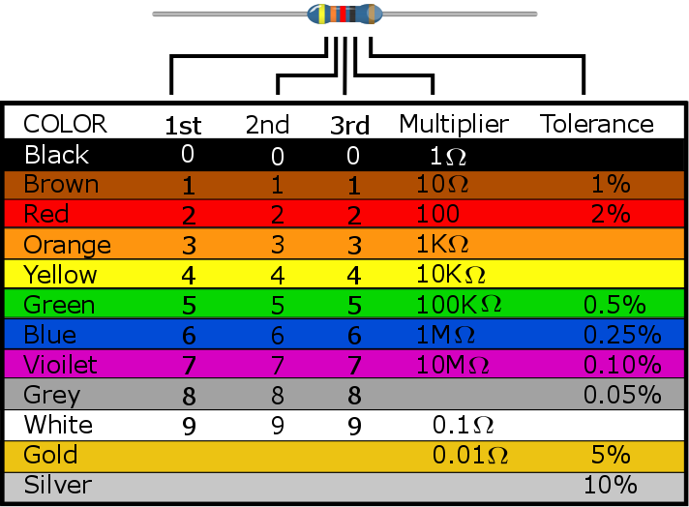

Slide 41
1V
2V
Voltage scale for Channel 1 (red) says 2V
-1V

Slide 42
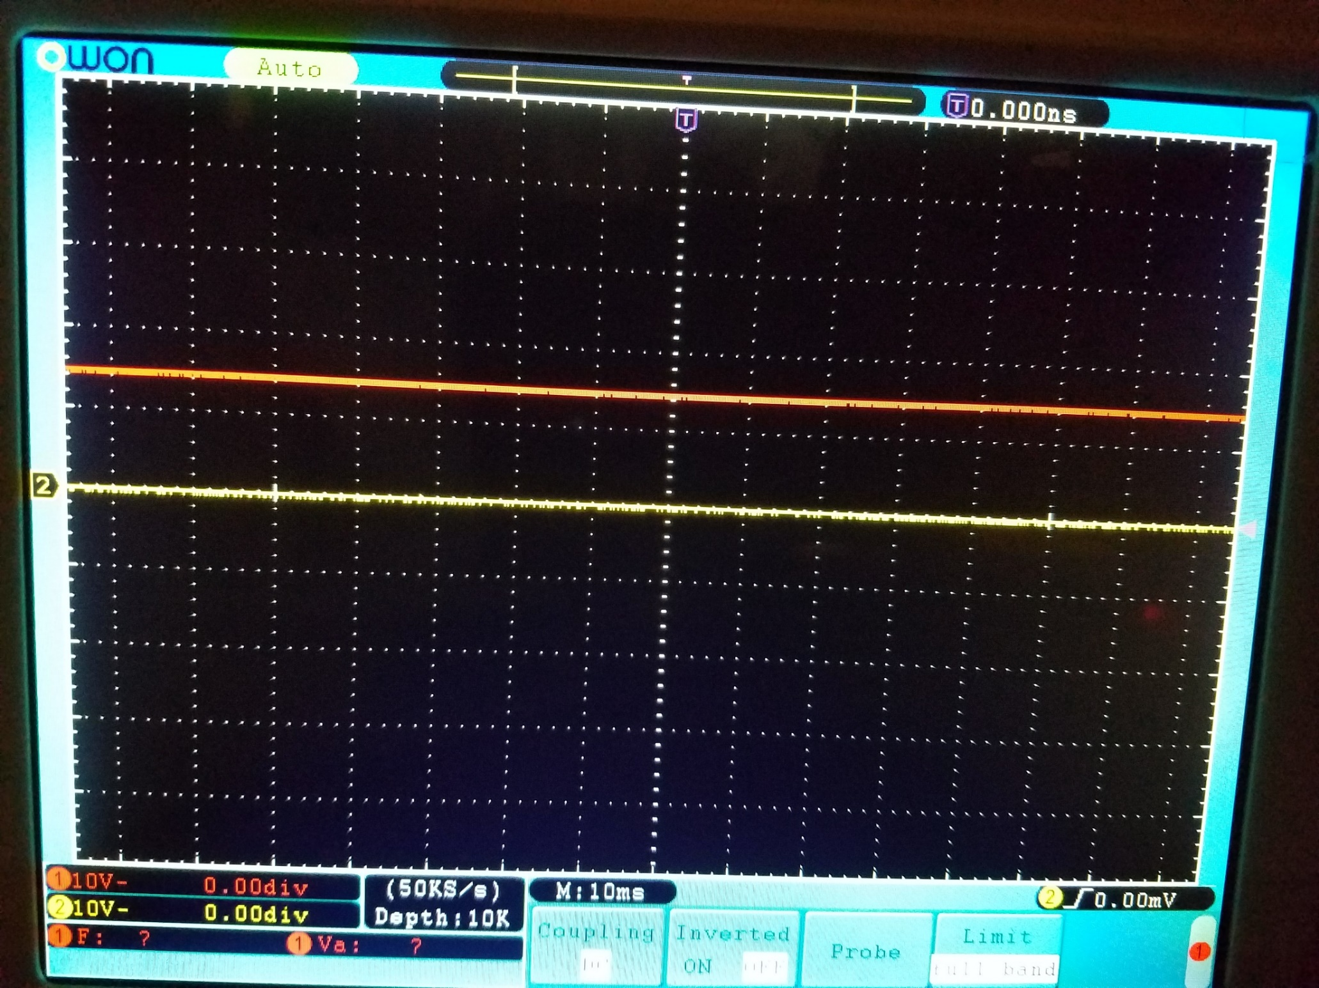

Slide 43
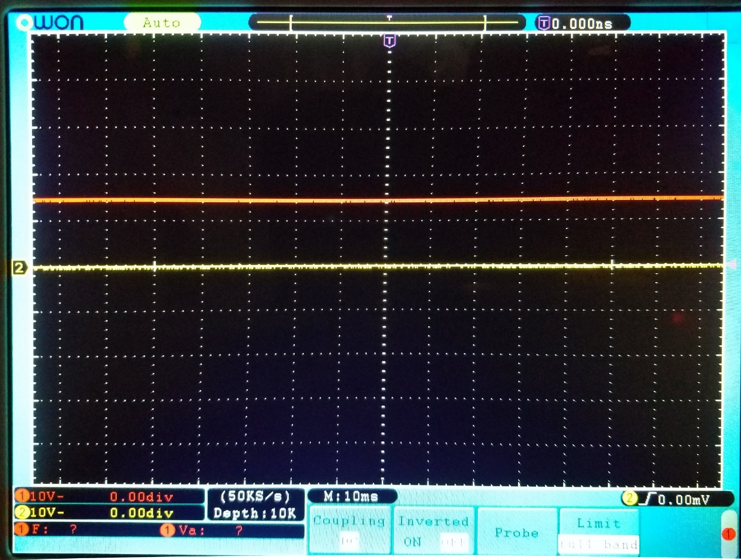
5V
1.5 V signal from a battery
10V
Voltage scale for Channel 1 (red) says 10V
-5V

Slide 44
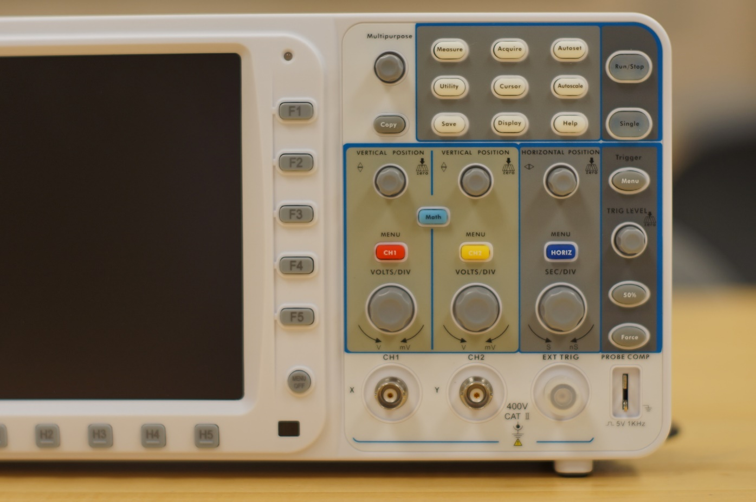
Calibration source

Slide 45
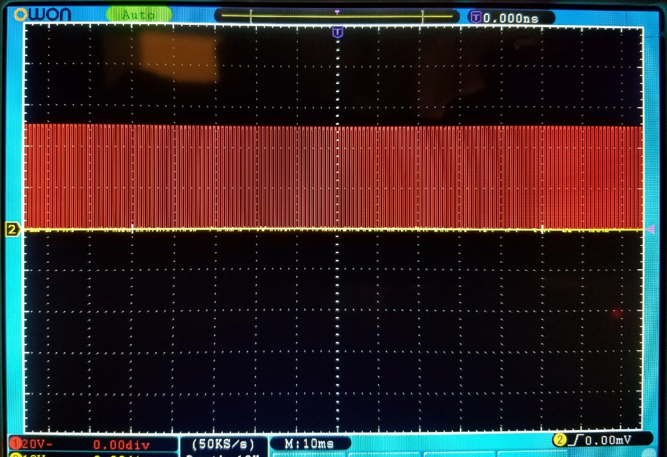
10V
5 V signal from O-scope
Calibration
Source
20V
Voltage scale for Channel 1 (red) says 20V
-10V

Slide 46
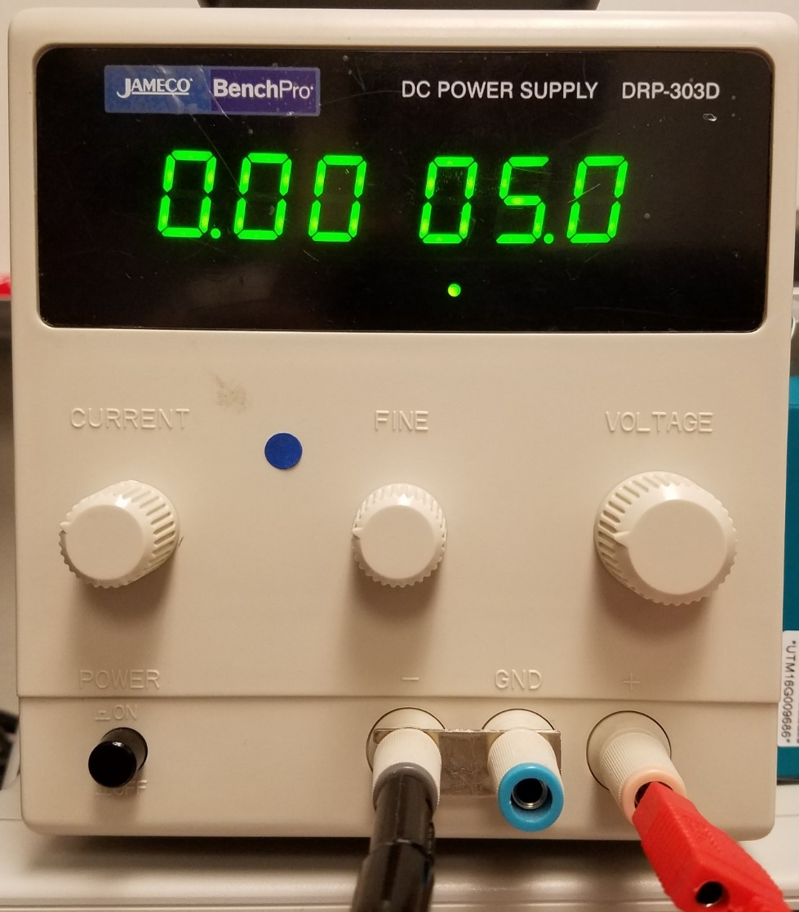
Rough Voltage Indicator
Rough Current Indicator
Voltage
Course Adjust Knob
Current
Limiter
Adjust
Knob
Voltage
fine Adjust Knob
Power Switch
Negative Voltage Out (GND)
Positive Voltage Out

Slide 47
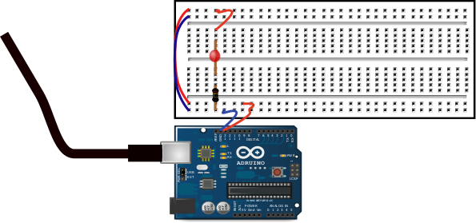
To Computer

Slide 48
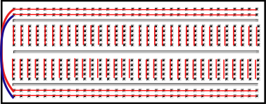

Slide 49
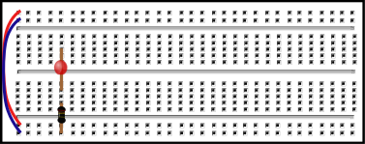
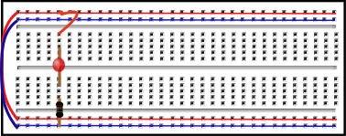
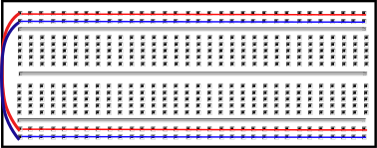
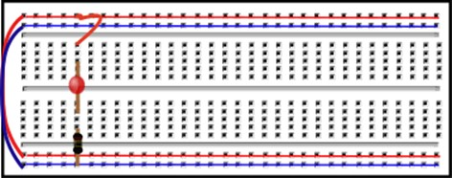
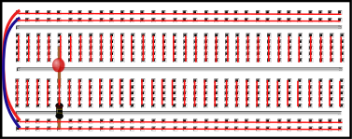

Slide 50
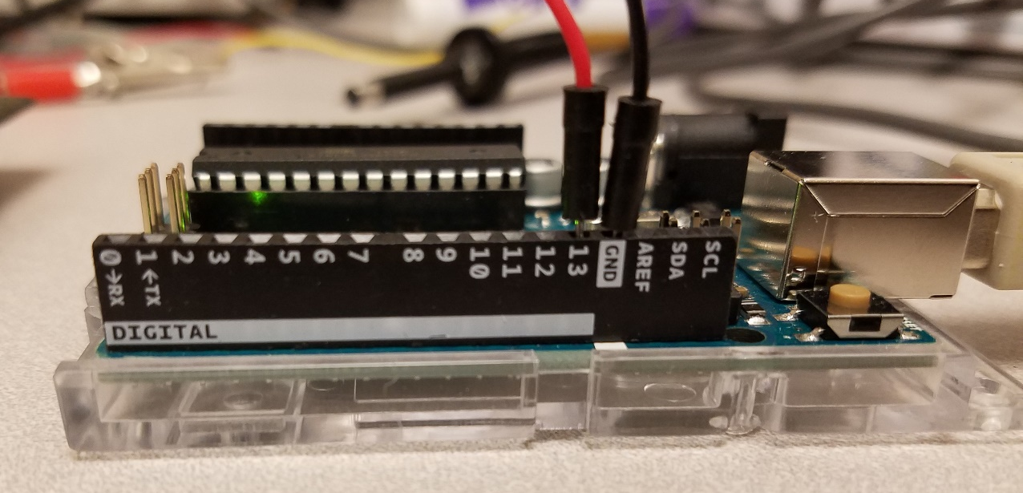
Pin 13
Ground

Slide 51
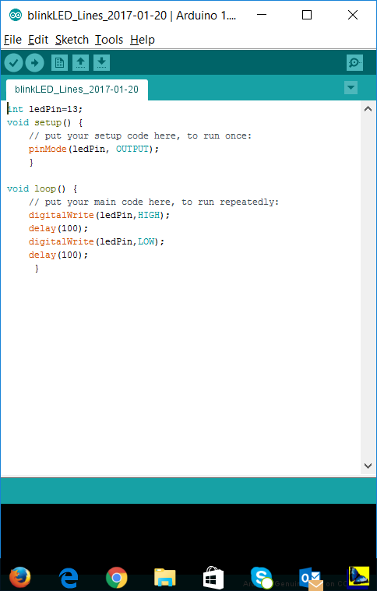
Upload to Arduino
Compile

Slide 52
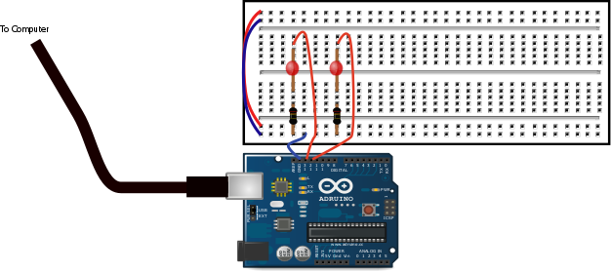

Slide 53
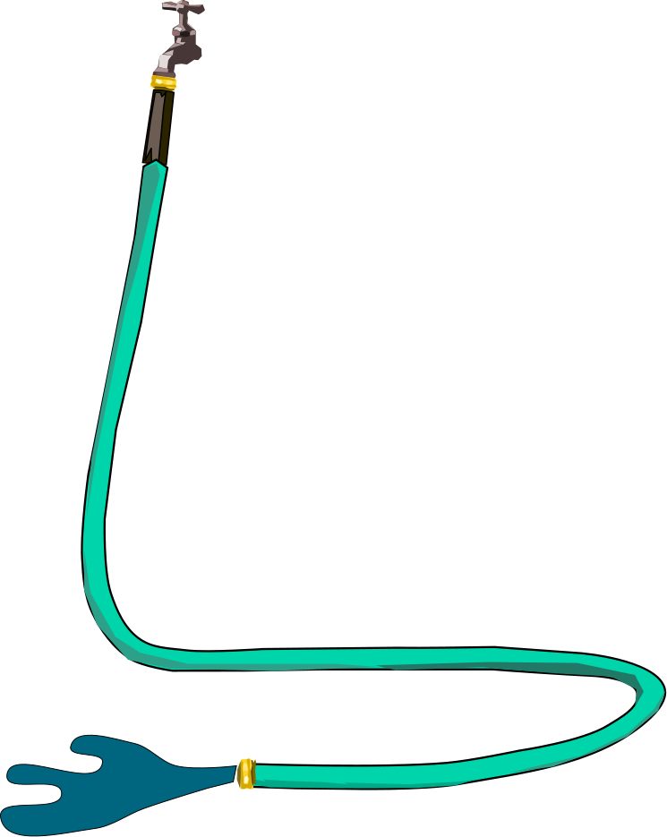

Slide 54
Case 1: Negative charges flow to the right
Result: Left side is more positive than before, Right side is more negative than before
Case 2: Positive charges flow to the left
+
+
+
+
Result: Left side is more positive than before, Right side is more negative than before

Slide 55
Current Flow Direction
Electron Flow Direction

Slide 56
Battery
R_{test}
ΔV
R_{s}
ΔV_{s}

Slide 57
1
Battery
R_{test}
ΔV
R_{s}
2
4
3
ΔV_{s}

Slide 58
Battery
R_{test}
ΔV

Slide 59
1
Pin A2
Battery
R_{test}
R_{s}
2
Pin A1
GND
4
3
Pin A0

Slide 60
1
Pin A2
Battery
R_{test}
R_{s}
2
Pin A1
GND
3
Pin A0

Slide 61
A
Battery
Resistor

Slide 62
ΔV_{ps} =3V
R = 5000Ω
R_{s} = 10Ω

Slide 63



Slide 64


Slide 65


Slide 66


Slide 67


Slide 68


Slide 69


Slide 70



Slide 71


Slide 73



Slide 74

Slope
Y-Intercept
Slope Uncertainty
Y-Intercept
Uncertainty

Slide 75
High Electrical
Potential Energy
Resistor
Battery
ΔV
Low Electrical
Potential Energy

Slide 76


Slide 77


Slide 78
R
R₁
Δv
A0
R₂
Measure
GND

Slide 79
R
Δv
R

Slide 80
From the Power Supply
+5V
R
R₁
A0
R₂
From the Signal Generator
±5V

Slide 81

Oscilloscope lead measuring in between the two resistors
Oscilloscope lead measuring the signal generator signal.
+5V from the Power Supply
R₁
R₂
±5V from the Signal Generator

Slide 82


Slide 83


Slide 84


Slide 85




Slide 86
R₂
R₁
V_{in}
-
+
V_{out}
V_{bias}
R₁
Δv
A0
R₂
Measure
GND

Slide 87


Slide 88


Slide 89


Slide 90


Slide 92



Slide 93


Slide 94


Slide 95


Slide 96


Slide 97
y
Down Hill in the
z direction
Down Hill in the
x direction
z
x

Slide 98



Slide 99


Slide 100



Slide 101


Slide 102


Slide 103

Push Run
Enter commands here
Result is here

Slide 104


Slide 105


Slide 106


Slide 107


Slide 108


Slide 109
Charging
C
R
ΔV_{battery}

Slide 110
Discharging
C
R

Slide 111
Charging
Discharging
C
C
R
R
ΔV_{battery}

Slide 112
2
1
C
R
ΔV_{battery}

Slide 113
2
1
Pin A1
Pin A0
C
R
ΔV_{battery}
GND

Slide 114
1
Pin A2
Battery
R_{test}
R_{s}
2
Pin A1
GND
4
3
Pin A0

Slide 115
1
Battery
R_{test}
ΔV
R_{s}
2
4
3
ΔV_{s}

Slide 116


Slide 117

Toolbar with Curve Fit Function
Data Area
Graph Area

Slide 118


Slide 119


Slide 121

Data Graph
List of
functions
“Try Fit” Button

Slide 122

The function
We want

Slide 123

The function
We want
“Try Fit” Button

Slide 124


Slide 125



Slide 126


Slide 127


Slide 128


Slide 129


r
LED Used as Light Detector
Light Point Source

Slide 130
Effective Lens
Actual LED

Slide 132



Slide 133


Slide 134


Slide 135


